Slide 1

Hugging Face

Slide 2
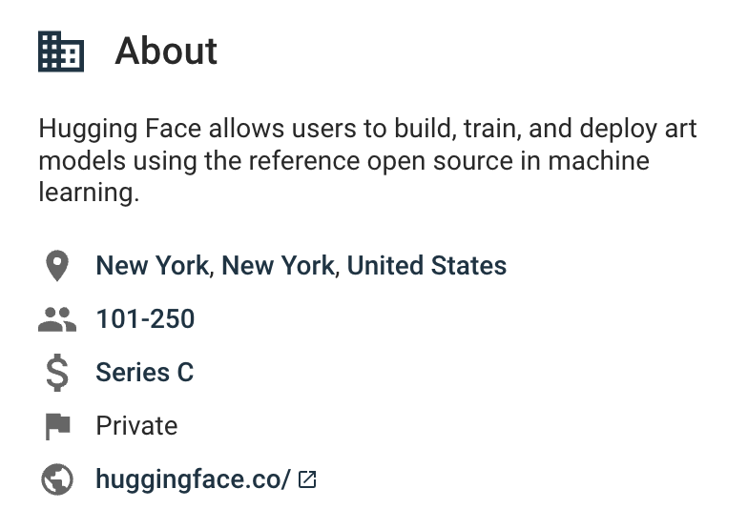
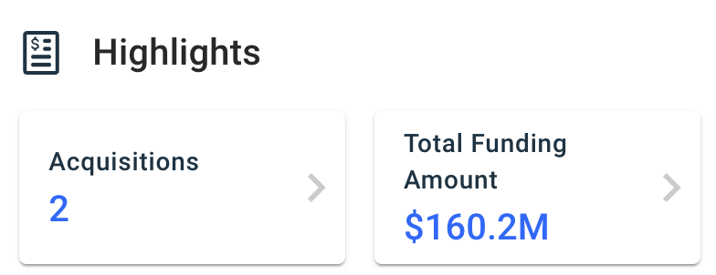
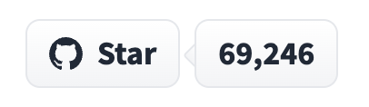
Hugging Face
Hugging Face is a large open-source community that quickly became an enticing hub for pre-trained deep learning models, mainly aimed at NLP. More than 5 thousand companies using it in production, including Google, Amazon, Meta and others. Hagging Face specific value is reusability — all available models come with a set of pre-trained weights that you can fine-tune for your specific use.

Slide 3
What does Hugging Face offer?
Hugging Face provides models, datasets and Spaces for a variety of tasks. Some of them are:
NLP
Text Summarisation
Question answering
Text classification (e.g. positive/negative)
Translation
Feature extraction
Audio
Text to speech
Audio classification
Voice activity detection
Automatic speech recognition
Computer Vision
Image classification
Object detection
Image segmentation
Text to image

Slide 4
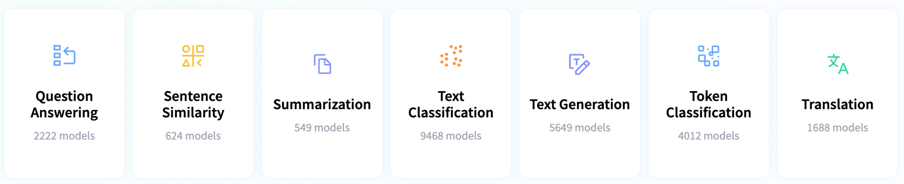
Natural Language Processing Tasks
Hugging Face offers a library of over 10,000 Hugging Face Transformers models. With just a few lines of code, you can import, train, and fine-tune pre-trained NLP Transformers models such as BERT, GPT-2, RoBERTa, XLM, DistilBert for various tasks, including:

Slide 5
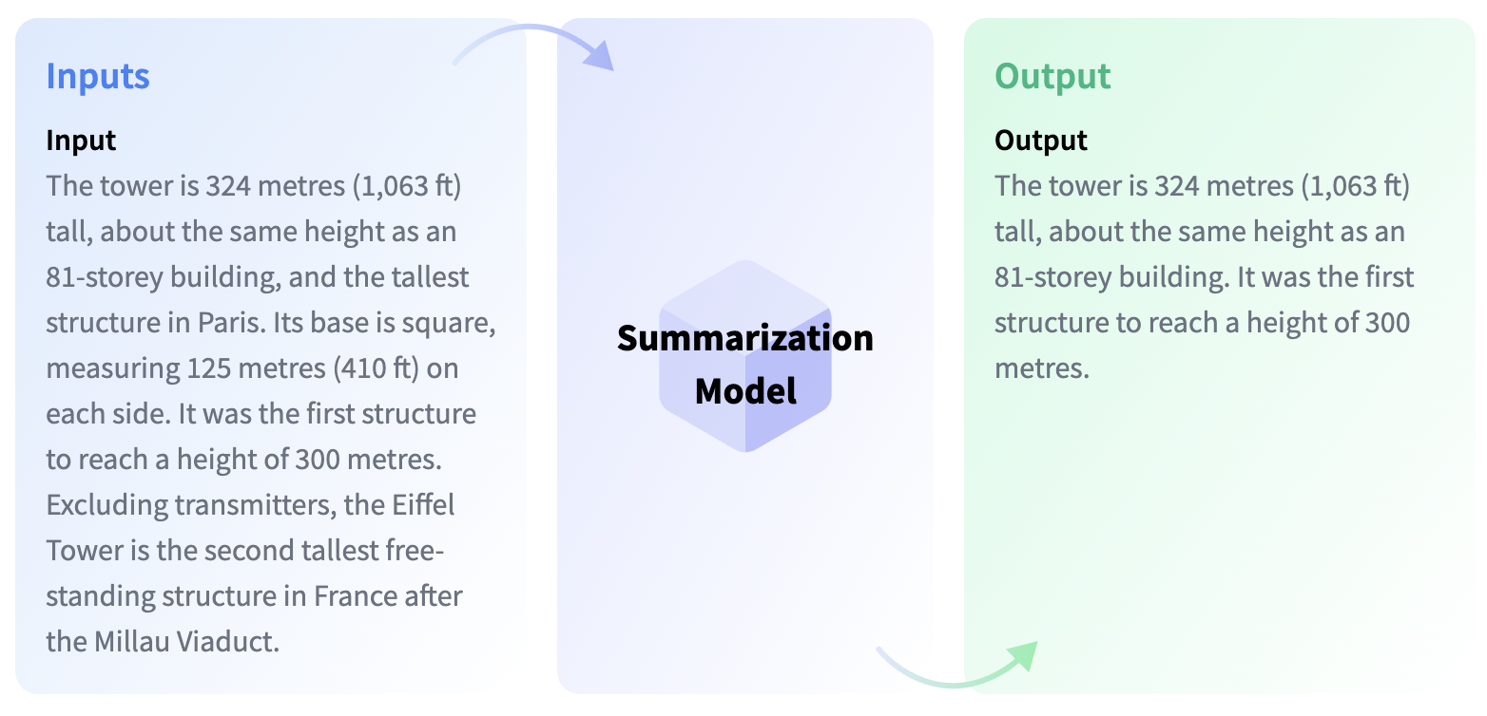
Summarization Task
Summarization is the task of producing a shorter version of a document while preserving its important information. Some models can extract text from the original input, while other models can generate entirely new text.

Slide 6
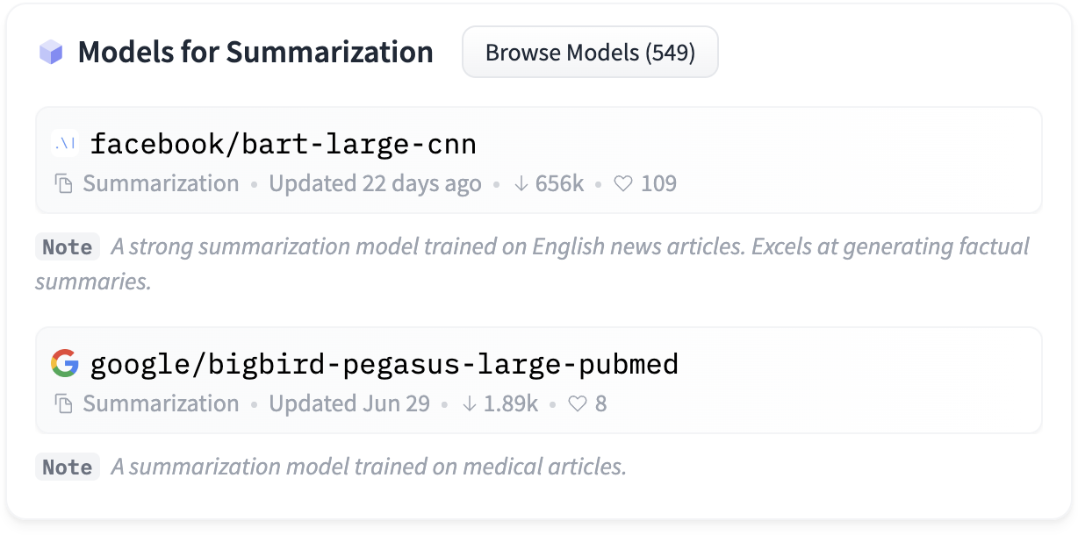
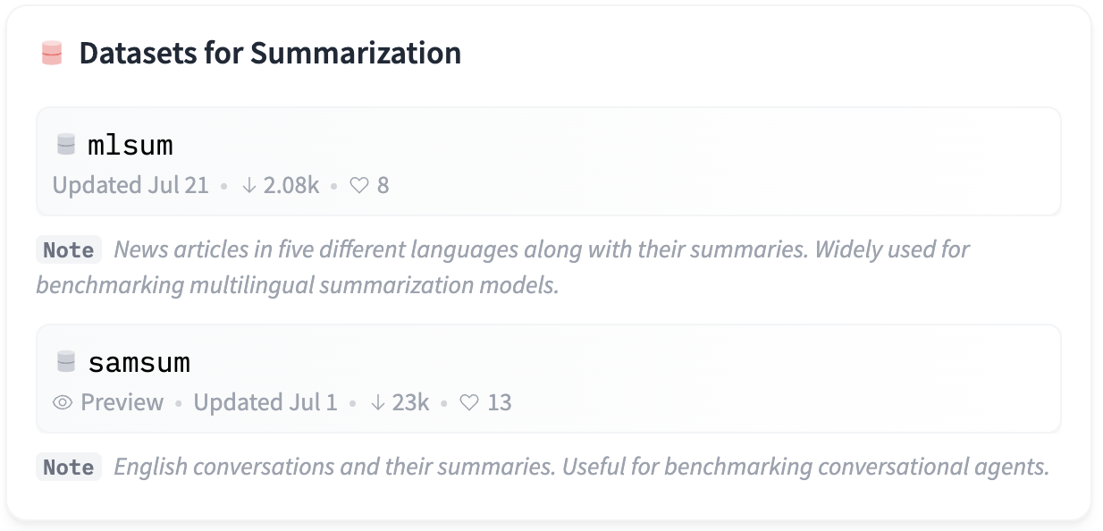
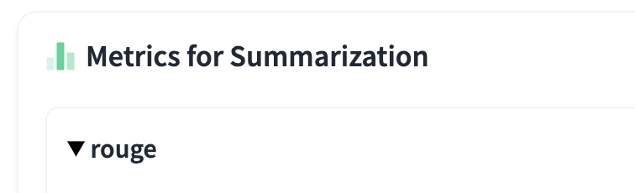
Text Summarisation task
Hugging Face provides summarization models pretrained on various datasets, including English news articles, medical articles, English conversations, etc. datasets for summarisation and metrics for automatic accuracy evaluation.

Slide 7
Benefits for Fidelity
In assistance with Hugging Face, we can generate custom Fidelity pretrained models based on open source models available at Hugging Face to serve Fidelity specific tasks, e.g. strong at generative summaries on investment reports.
Hugging Face can assist in generating datasets for fine tuning the models free from bias, as their strong accent is on AI ethics and tools for detecting and removing bias from the data that are used to train AI algorithms.
Hugging Face provides secure infrastructure for deploying the models for high volume workloads and inference or you can leverage its integration with AWS SageMaker and others.

Slide 8
Supported Plans
Hugging Face provides several plans Community and Organisations. The benefits of Enterprise plan:
Expert support
Direct, dedicated support from the Hugging Face team to accelerate your ML roadmap from modeling to production
Private Hub
Unlimited private models, datasets, Spaces and users with access control administration
Infrastructure as a Service
Dedicated hosted endpoints or managed deployments for high volume workloads
Advanced Security
Secure hosted endpoints with automated data deletion upon inference

Slide 9
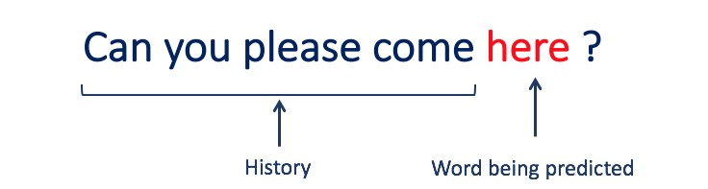
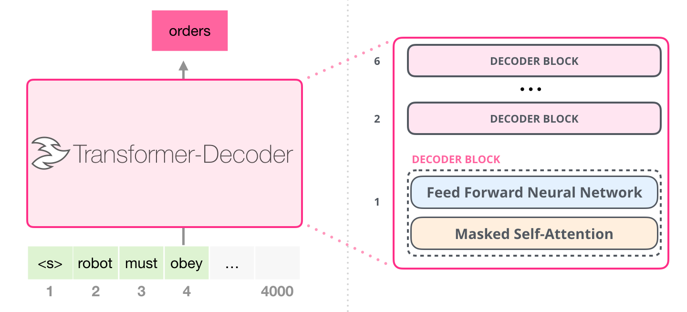
What is a Language Model
Language models are a crucial first step for most of the advanced NLP tasks. Simply put, language models are statistical tools to predict the next word(s) in a sequence. In other words, language models are probability distribution over a sequence of words.
Language models have many applications like:
Machine Translation
Text Classification
Speech Recognition
Information Retrieval
News Article Generation
Question Answering, etc.
Language models — among other things — can suggest the next word we type. Source
There are two types of Language Models:
Statistical Language Models: These models use traditional statistical techniques like N-grams, Hidden Markov Models (HMM) to learn the probability distribution of words
Neural Language Models: They use different kinds of Neural Networks to model language

Slide 10
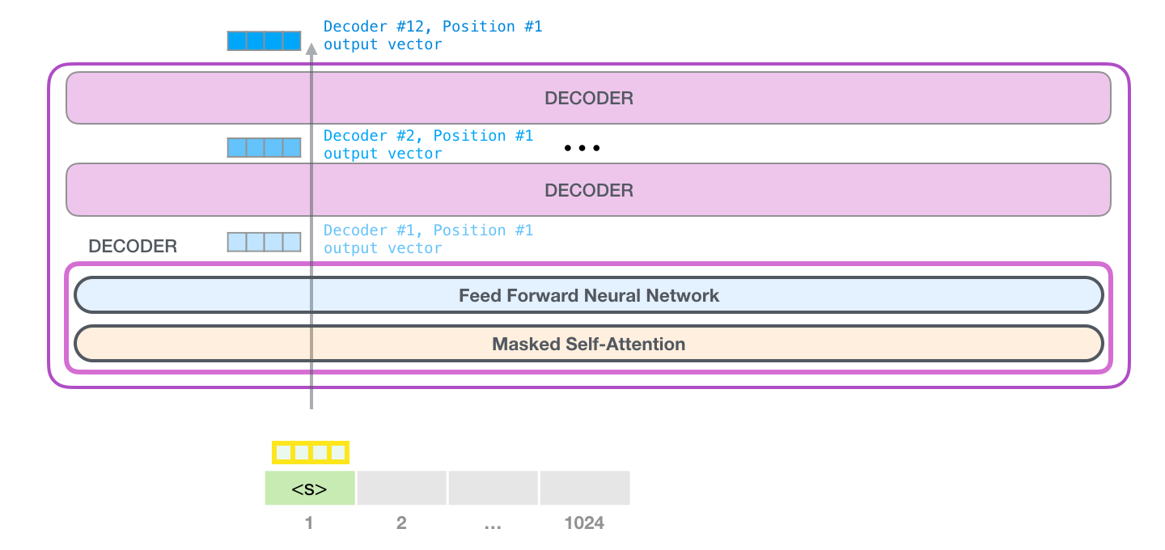
GPT-3
Generative Pre-trained Transformer 3 (GPT-3) is a language model that employs deep learning to produce human-like text. It is the 3rd-generation language prediction model in the GPT-n series created by OpenAI, a San Francisco-based artificial intelligence research laboratory. GPT-3's full version has a capacity of 175 billion machine learning parameters. Microsoft announced on September 22, 2020, that it had licensed "exclusive" use of GPT-3; others can still use the public API to receive output, but only Microsoft has control of the source code.
The model is built using the standard concepts of Transformer, Attention, etc, and using the typical Common Crawl, Wikipedia, Books, and some additional data sources. The GPT-3 is built using transformer decoder blocks. GPT-3, like traditional language models, outputs one token at a time. after each token is produced, that token is added to the sequence of inputs. And that new sequence becomes the input to the model in its next step. This is an idea called “auto-regression”.
The smallest GPT-3 model (125M) has 12 attention layers, each with 12x 64-dimension heads. The largest GPT-3 model (175B) uses 96 attention layers, each with 96x 128-dimension heads.

